Slide 1

Stenokeyboard
Výstup 4
Vojtěch Nebes, 3. A

Slide 2
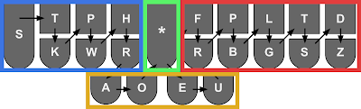
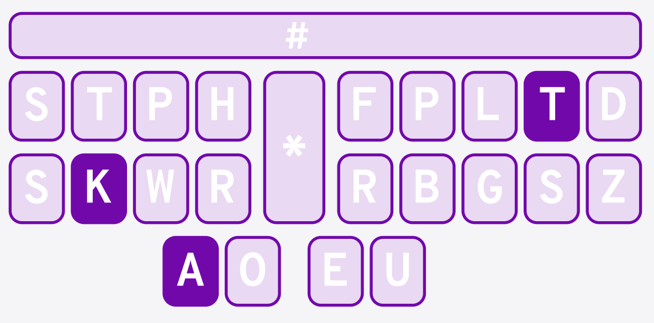
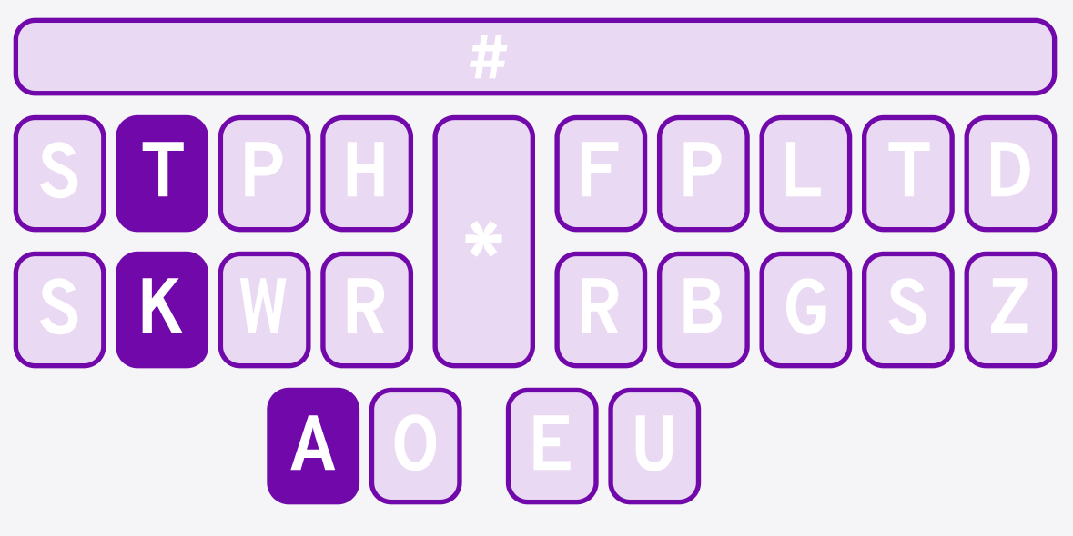
Teorie
KAT -> "cat"
TKA

Slide 3
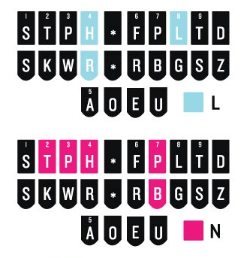
Akordy
"long"
HR
O
-PB
-G
HRO-PBG

Slide 4
Firmware???
0 1 2 3 16 4 5 8 9 10 11
12 13 14 15 17 6 7 20 21 22 23
18 19 24 26 27 28
29b 0=12, 18=28, ... 23b 3B

Slide 5
Firmware???
chord_state: 00000000 00100100 01000000
chord_state: 00000000 00100100 00000000
+
key_state: 00000000 00000000 01000000
uint_8t* hw_keyboard_scan();
key_state: 00000000 00000000 01000000

Slide 6
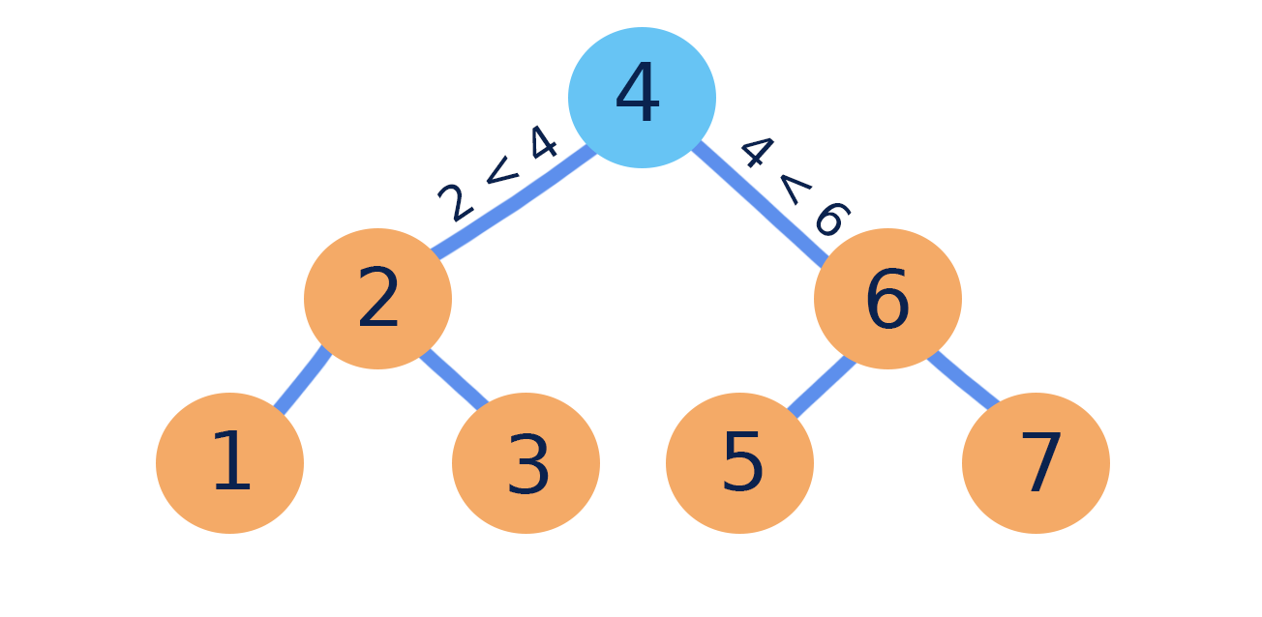
bool is_keyboard_empty();
true
00000000 00100100 01000000 01100011 01100001 01110100 \0 \0 \0 \0 \0 \0 \0 \0 \0 \0 \0 \0 \0 \0 \0
KAT
c
a
t

Slide 7
void process_write(...);

Slide 8
Sekvence
KPHEPBLT
"comment"
KPHEPBLT/TAER
"commentary"
SPWR/TKEUS/PHREUPB/AER
"interdisciplinary"

Slide 9
py generate_dict
JSON
Binary
{ "-T": "the", "TO": "to", "KAT": "cat" }
00000000: 40 80 00 74 6f 00 @..to.
00000006: 09 02 00 63 61 74 ...cat
0000000c: 00 02 00 74 68 65 ...the
Akord -T
"the"

